Slide 1
Indigenous System
of
Natural Resource
Management

Slide 2
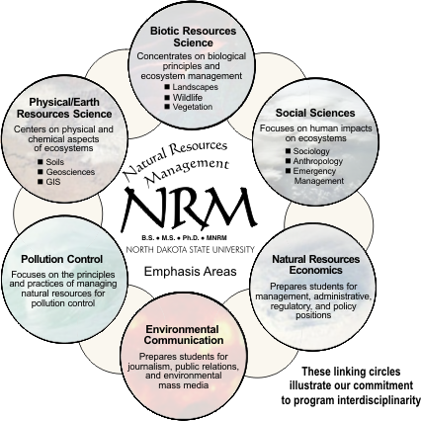

Slide 3
Natural Resource Management
Management of natural resources such as land, water, soil, plants and animals
Focuses on how management affects the quality of life
Brings together land use planning, water management, biodiversity conservation, and the future sustainability of industries
Focuses on scientific and technical understanding of resources and life supporting capacity of those resources

Slide 4
What is Indigenous Knowledge?
knowledge that is unique to a given culture or society
contrast with the international knowledge system
basis for local-level decision making in agriculture, health care, food preparation, education, natural-resource management
Indigenous information systems are dynamic, and are continually influenced by internal creativity, experimentation and experience

Slide 5
Importance:
encompasses the skills, experiences and insights of people, applied to maintain or improve their livelihood
essential for sustainable development as the availability of physical and financial capital

Slide 6
Indigenous System to Natural Resource Management
Well poised to reduce deforestation rates, overcome land and water management problems
provide a rich array of experiences, expertise, and practices that can significantly contribute to protecting biodiversity, food security, and sustainable livelihoods in indigenous communities

Slide 7
Indigenous System of Forest Management
Some of the rules adopted by the indigenous systems of forest
management include
only harvesting selected products and species,
harvesting according to the condition of the product,
limiting the amount of product, and
using social means of monitoring.

Slide 8
Indigenous System of Land Management
Following guidelines can be used
Plan for long-term change and unexpected events
Preserve rare landscape elements and associated species
Avoid land uses that deplete natural resources.

Slide 9
Continued…
Avoid or compensate for the effects of development on ecological processes
Implement land-use and land-management practices that are compatible with the natural potential of the area

Slide 10
Guidelines for Indigenous participation to Natural Resource Management
Indigenous people need to be represented on regional decision- making committees
consulting and incorporating the views of all peak Indigenous organizations

Slide 11
Continued…
The regional plan will contain a section that responds to legislative and legal requirements and responsibilities. This section should include any such matters relating to Indigenous land and water management
Indigenous community should be identified and their interests taken into account through direct consultation

Slide 12
Conclusions
participation of local community members, including women and elders, is essential in all aspects of implementation: research, planning, and training
indigenous knowledge systems reflect cultural values as well as technical knowledge – hence, understanding these systems introduce great changes
existing local organizations and informal associations must be recognized and strengthened to meet the development needs and management of natural resources

Slide 13
THANK YOU!!!

